Slide 1
Order Management System for B2B Businesses
Optimizing Order Workflows and Resource Utilization
Mate Gumberidze
Shaka Mirtskhulava
Tbilisi State University

Slide 2
01
Introduction
02
Purpose of this porject
03
Table Of Contents
Task Overveiw
04
Ways to execute tasks and Time table
05
Expected Results

Slide 3

What is Order management system and why is it important.
Order Management system is a digital solution for managing orders, inventory, and stock processes. It is critical for B2B transactions (Business to business), focusing on efficiency and collaboration.
B2B businesses face logistical challenges in managing multiple orders. Existing tools like Zoho Inventory focus on inventory but lack order prioritization algorithms.

Slide 4
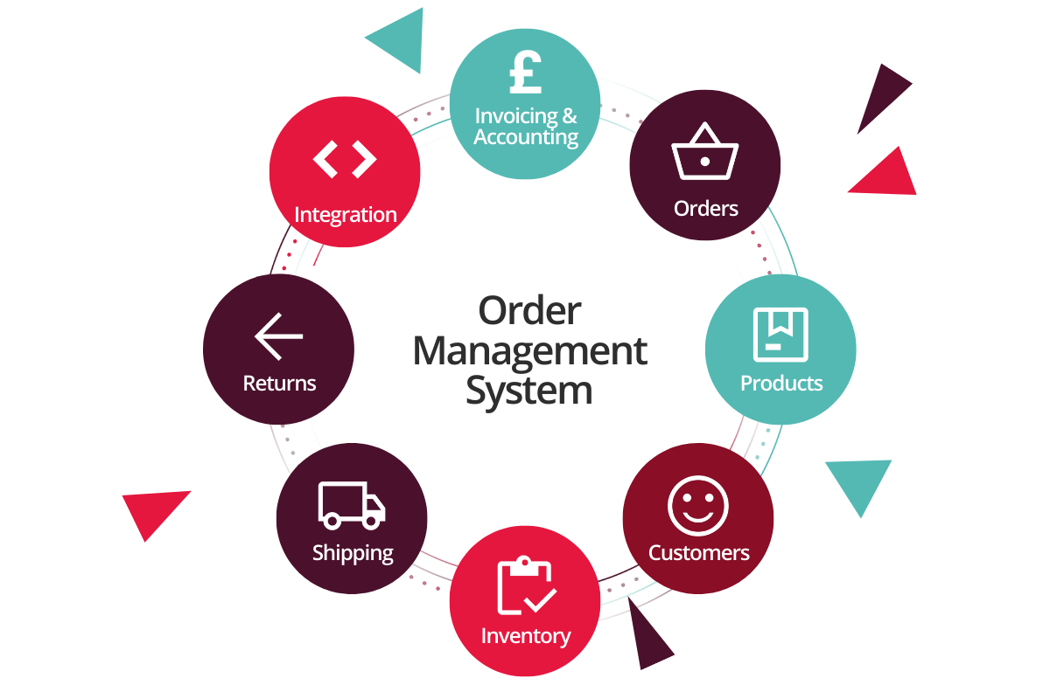
Core Purpose of the Project
Project's purpose it to enhance operational efficiency, optimize resource utilization in product distribution.
It proposes A custom batch-processing algorithm prioritizing orders by deadlines, location, and priority. Advanced role management for better control and efficiency.

Slide 5
Tasks Overview
Key Features to be Developed
User authentication and authorization.
Inventory and product management.
Stock adjustments by staff members.
Order placement and management (review, approval, rejection).
Algorithm for order batch processing and optimization.

Slide 6

Task 1 - User Authentication
Features:
Secure login system using unique credentials (email and password).
Password recovery via email confirmation.
Email and password update post-login.
Role Management
Administrator/root users register employees with different roles.

Slide 7

Task 2 - Product and Stock Management
Product Management:
CRUD functionality for products (add, edit, delete).
Upload images and initial stock quantities.
Stock Management by Staff:
Update stock based on operational needs.
Track changes and ensure inventory accuracy.

Slide 8

Task 3 - Order Processing and Management
Order Management:
Users can place orders specifying product type, quantity, and delivery date
Order Review:
Administrators can review, approve, or reject orders.
orders can be filtered based on status (pending, approved, rejected).

Slide 9
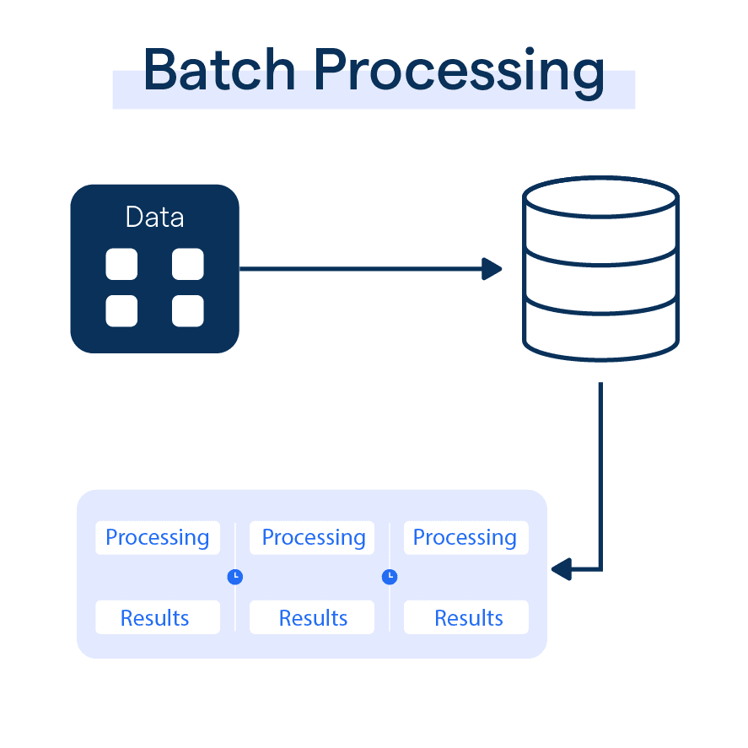
Task 4 - Batch Processing Algorithm
What makes This unique?
With Batch processing the orders can be processed by their shipping date, Priority, Location.
What benefits does it have
Batch processing reduces delays, optimizes resource allocation and Increases system reliability and scalability.

Slide 10
Ways of Executing These Tasks
Technologies and Tools:
Programming Language: ASP.NET Core (back-end)
Database: MS SQL for robust storage and tracking.
Front-End: React/Angular for dynamic interfaces.
Frameworks: Identity for authentication, custom ORM.
Development Stages:
Planning and requirement gathering.
Feature implementation in iterations.
Testing for functionality and security.

Slide 11
Activity: Design and Implement System | Month I |  |  |  | Month II |  |  |  | Month III |  |  |  | Month IV
 | I | II | III | IV | I | II | III | IV | I | II | III | IV | I | II | III | IV
Design user authentication module
Develop inventory management functionalities
Initial design and layout of the user interface

Slide 12
Activity: Order Management and Batch Processing Algorithm | Month I |  |  |  | Month II |  |  |  | Month III |  |  |  | Month IV
 | I | II | III | IV | I | II | III | IV | I | II | III | IV | I | II | III | IV
Develop order placement and management workflows
Design and implement batch processing algorithm
Implement order review and approval by admin

Slide 13
Activity: Testing, Deployment, and Documentation | Month I |  |  |  | Month II |  |  |  | Month III |  |  |  | Month IV
 | I | II | III | IV | I | II | III | IV | I | II | III | IV | I | II | III | IV
Conduct unit and manual testing
Debug and refine features
Deploy to production environment
Develop user documentation

Slide 14
Expected Results
Outcomes for Businesses:
Improved efficiency in order management and resource utilization, Reliable and scalable system for B2B logistics and Secure workflows with advanced role management.
Algorithm Impact:
Significant reduction in processing delays. Optimal use of resources by grouping and prioritizing orders

Slide 15
Conclusion
The Order Management System is a robust solution tailored for B2B businesses.
Its unique algorithm and role management will provide a competitive edge.

Slide 16
Thank You For Your Attention

